Slide 1
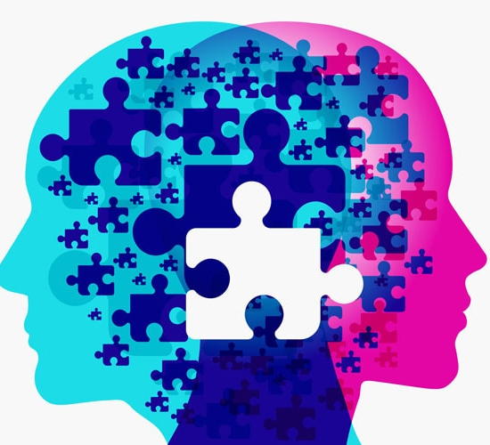
Dsw ctrl intelligence
Presenter: NANDI
given

Slide 2
GROUP MEMBERS
S. DHLAMINI 220046269
SL MDAWENI 220052531
KM KASONGO 220024976
DW LEPHALE 219044856
NL DITHEBE 220044448
G SITHOLE 219019487

Slide 3
PRESENTATION OUTLINE
Introduction
What is mental health
Why it is important to know about mental health
Why it is vital to seek help when needed
Goal:
Present an effective and innovative way to tackle and solve the social issue that is mental health (or the lack thereof) and illness by means of a website.

Slide 4

PROBLEM STATEMENT
Mental health has been hidden behind a curtain of stigma and discrimination for too long in our societies. In the last few years, the world has become more aware of this enormous burden and the potential for mental health gaps. Therefore, we can make a tremendous impact using existing knowledge.

Slide 5
PROJECT OBJECTIVES
The objectives are:
To reduce stigma associated with mental illness
To raise awareness about the mental health and mobilise efforts in support of mental health
To make people understand what mental health is
To promote help seeking behaviours because it is okay to ask for help.
To provide users with a safe space and assist them with ways in which they can self soothe/cope as well as resources they can make use of to reach out for help or seek support.

Slide 6

PROPOSED SOLUTION
Our website aims to guide users in the discovery of mental health and how to alleviate the burdens and avoid deaths due to these mental disorders. Moreover, outline effective treatments and interventions which also include self coping strategies.
In addition, the aim is to also educate the society about mental disorders and how to identify them as some are hidden like depression.

Slide 7
SOLUTION DESIGN/ARCHITECTURE
Our Let’s Heal website will provide the users with resources which will enable them to ask help from different organisations or hotlines that deal with the mental disorders outlined above.
The Home page will educate users briefly on mental health in general which is an important part of the solution to the problem (mental health stigmas and miseducation).
The Types page will provide users with information regarding the common different types of mental illnesses, their respective signs and symptoms as well as their causes and ways in which users can self-cope.
The Myths and Truths page will inform users of the common myths about mental health and issues and provide the facts about those mental health and illness myths.
The Resources page will provide users with hotlines and mental health support groups which they can contact and reach out to in times of need and at urgent risk. In addition, we will enable users to engage with our Chatbotwhenever they’d like to talk to someone.

Slide 8
TECHNOLOGIES USED
Our Let’s heal website utilised a chat software which is the chatbot in the website that will assist persons who need help
We also utilised social media tools such as YouTube videos to demonstrate what mental health is.

